Slide 1

Adjustable Bed Controller..
Hacked!!
www.itdiscovery.info/adjbedhack
$130 for a remote control? No way!!

Slide 2

The Premise
$130 for a remote control that costs $1.30 to make.
Notes:
Spending that kind of money when I know full well that the cost is no where near that I find outrageous. It made me so mad that I did this:

Slide 3
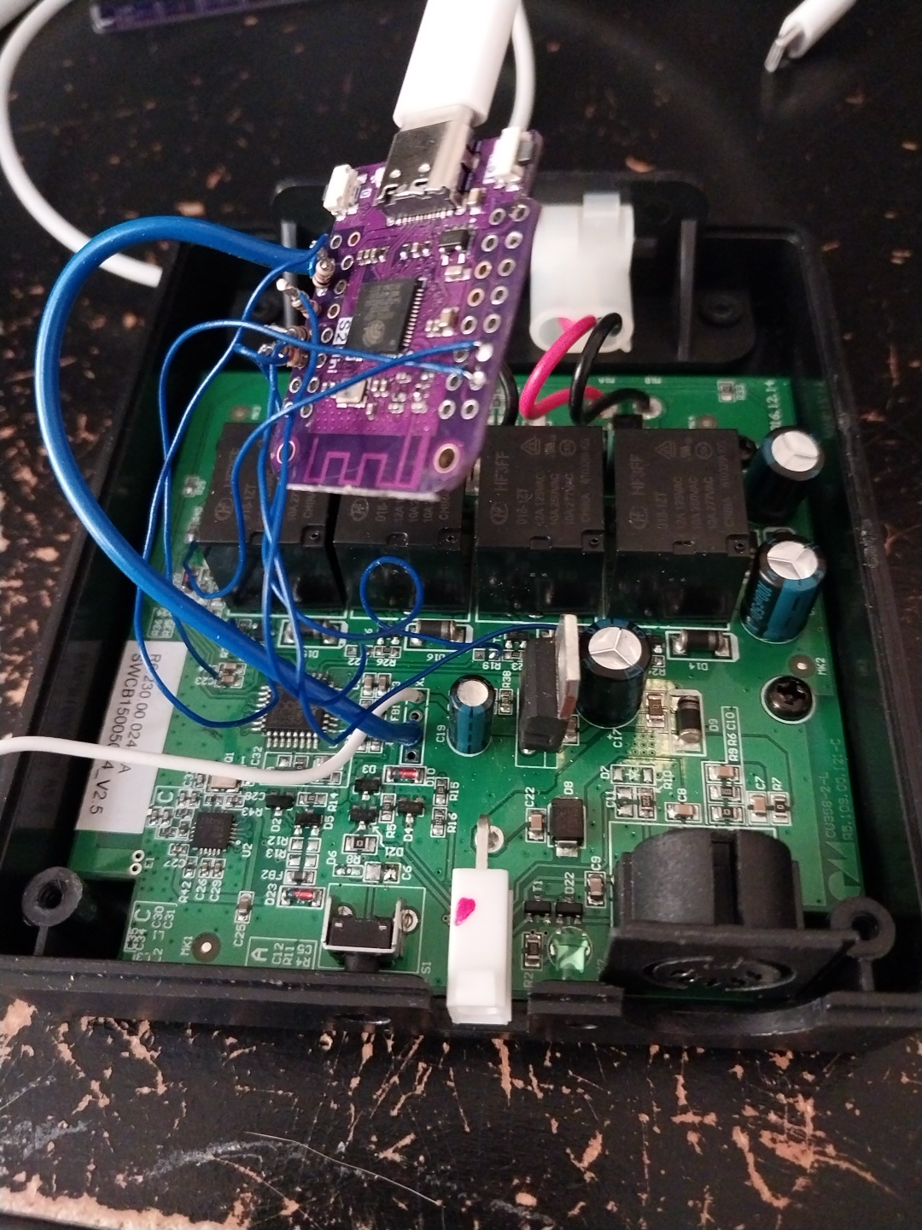
The Result
Hack time!!
Notes:
That’s right, you get your product reverse engineered, and since I was really angry, rather than competing, I just put made it open-source so anyone could do it.

Slide 4
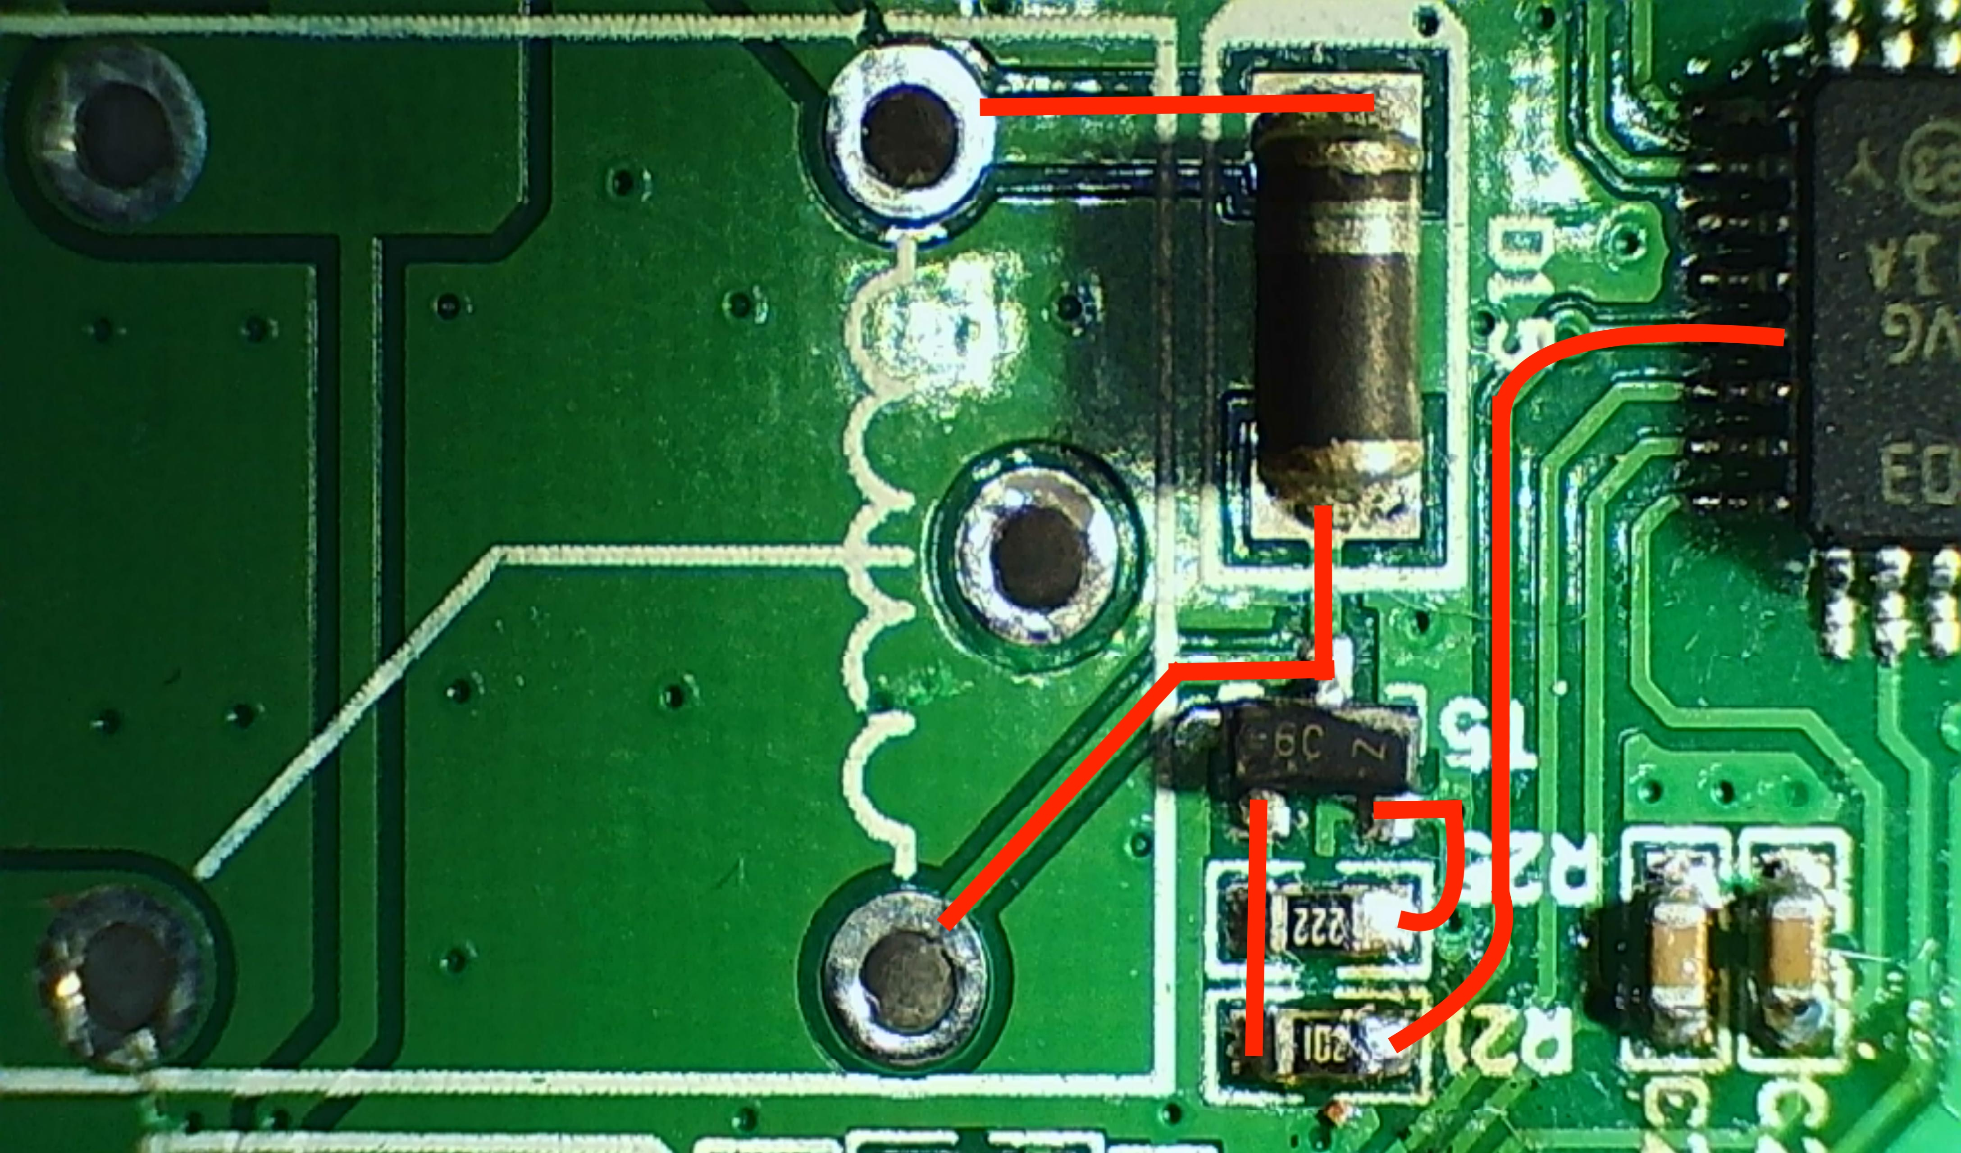
Turning on a Relay
STM8S003 generates a 3.3V logic high,
Turns on T5 to power the relay coil,
Sends 29V to the motor.
Notes:
It uses a standard (but pretty old and cheap) STM8S003 micro controller via a 3.3V GPIO to drive the base of an NPN transistor (see R21 and R22). When the transistor T5 is on, current flows through the coil of the relay to ground, and the relay switches from 3-4 to 3-5, turning the motor on in that direction. There are 3 more of these circuits to provide the two motors with two directions. The relays are wired similar to what you would see with light switches ganged together.

Slide 5
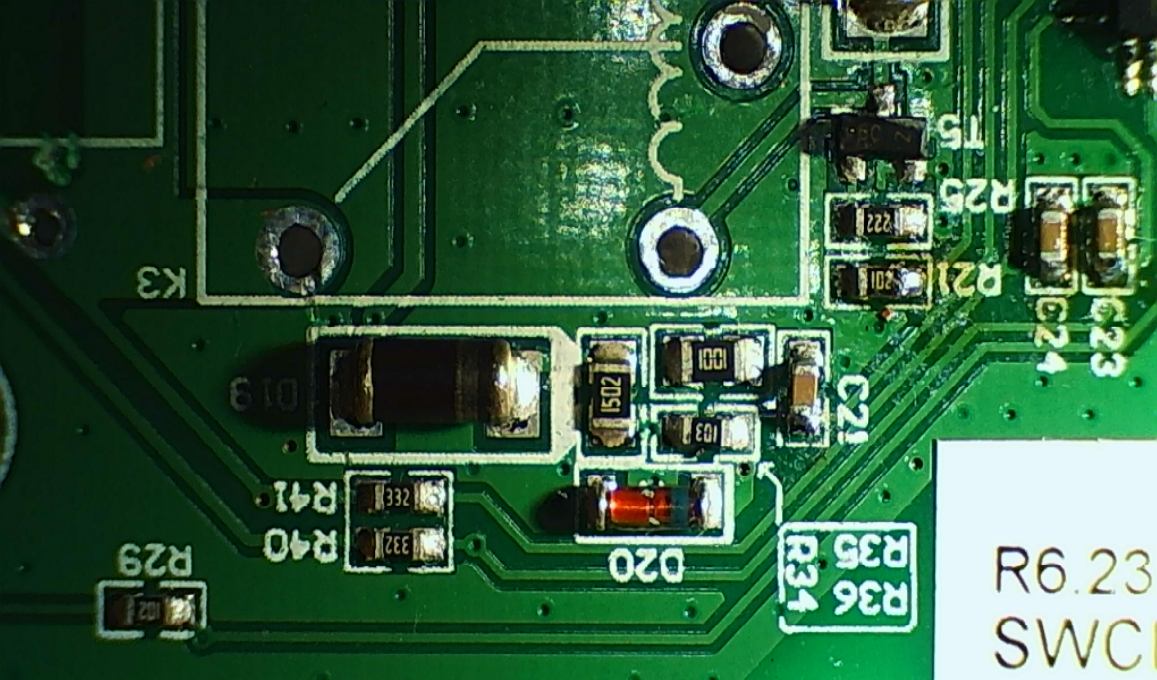
Catch of the Day
Shunt resistor in series with the motor,
R41 drops the voltage to within safe range,
Does not matter which relay is on.
Notes:
There's a catch though:
These motors have a switch in them so that when the motor has reached maximum or minimum, the motor turns off. The microcontroller must keep an eye on that so that it can switch off the relay when the motor goes to open circuit. That's pretty easy, as you can see here:
This connects the NC part of the relay (3-4) via a shunt resistor and a dropping resistor R41 and damping capacitor C24 back to the the microcontroller analog input. That's placed so that it doesn't really matter which relay of the pair (K3 and K4 in our case) is on, voltage will drop as long as the motor is running. You can see the companion circuit for the other motor here at R40/C23.

Slide 6
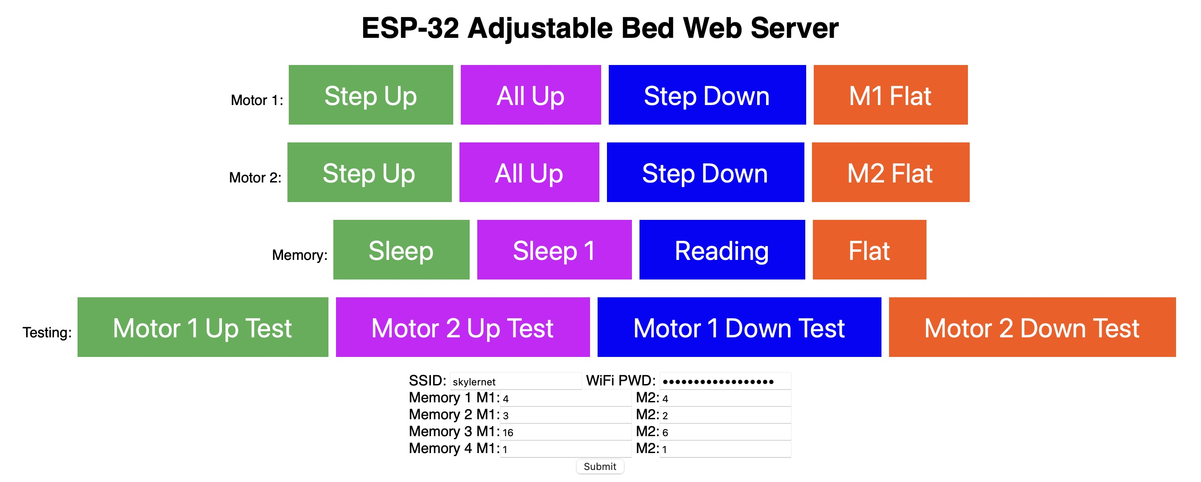
The Code and Result
void MotorOn(int relaypin, int motorpin, int runtm) {
digitalWrite(relaypin, HIGH);
int j=0;
delay(100);
while ((j<=runtm) && (analogRead(motorpin) > MotorOnThresh)) {
j++;
delay(100);
}
digitalWrite(relaypin,LOW);
//Add delay for multiple MotorOn commands
delay(400);
}
Notes:
It requires a little experimentation to understand what the threshold is for when the motor is on versus off. I measure that input every 100mSec and send the output LOW if the motor hits the endstop.
Add a crappy web page, and you now have an Adjustable Bed that your neighbor can taco you in at 3AM.

Slide 7

Replacement Controller
That $129 is only for the box and remote, you still need $30 for the power supply.
Lots of examples to turn on two motors in two directions.
Notes:
I just lost my remote (never mind that it didn't have any memory settings), so I just hacked the controller board, but this is a pretty easy circuit to design, and there are much more robust examples to turn on two motors in two directions.

Slide 8
Controller Design
2 Pairs of 2 Relay Circuits
Opto-isolator to protect ESP-32,
Feedback circuit using shunt resistor.
Speed controlling MOSFET
4 in 1 Opto-Isolator to save cost and board space.
Notes:
My design moves the speed controlling MOSFET to the input of both relays primarily because the software should never run both motors at the same time. The MOSFET circuit is optional, it just seems safer to me to allow the microcontroller to shut down the power if it sees a safety issue (like overheating). The opto-isolator I combined into a single package, as 4 are pretty close to the same price as one. That is a standard (but more expensive) solution that protects the ESP-32 if the switching transistor ever fails by shorting out.

Slide 9
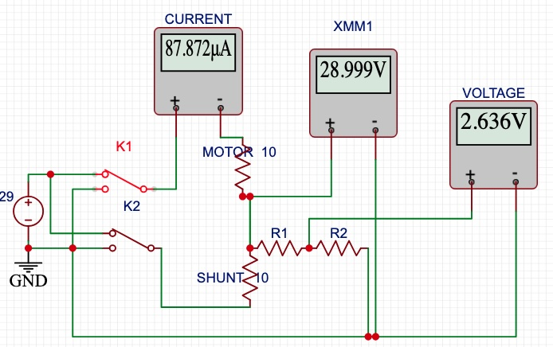
Motor Control and Feedback
Notes:
Here’s our starting state, both are off, so both sides of the motor are at 29V, so no current flows.

Slide 10
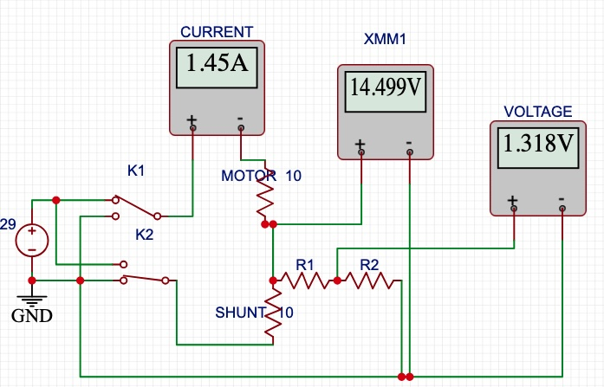
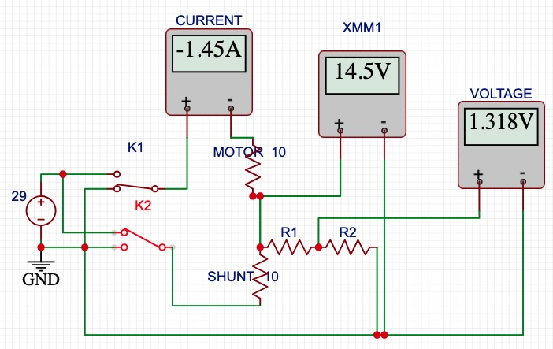
Motor is On
Notes:
One relay is on, so current will flow through the motor, but the voltage will be the same between the motor and shunt resistor.

Slide 11
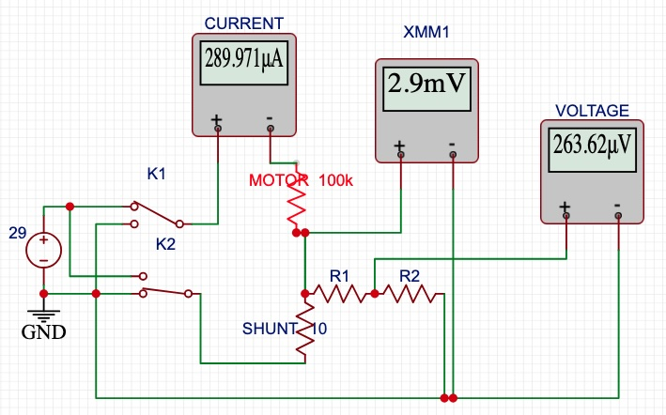
Motor has stopped!
Notes:
Look what happens when the motor becomes an open circuit: the corresponding voltage also goes to zero.

Slide 12
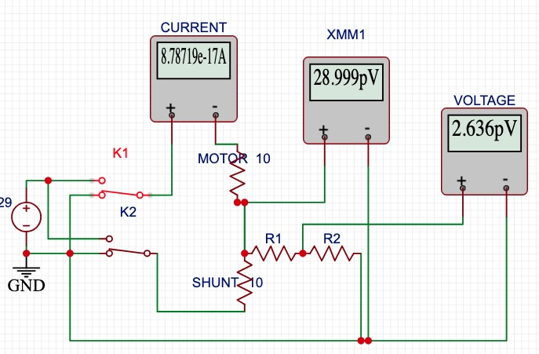
Don’t do this!
Notes:
Turning on both relays via the ESP-32 will send both sides of the motor to ground. Don’t forget that in order to keep this state you have to continue sending current through the relays. Really just avoid this state.

Slide 13

Questions?
More at: https://github.com/ITDiscovery/AdjBedController
Notes:
As of this presentation, I have not tried this circuit. I do have Gerber files for a board and the schematic on the GitHub page, and 5 boards are now on their way from JCLPCB.

